Slide 1

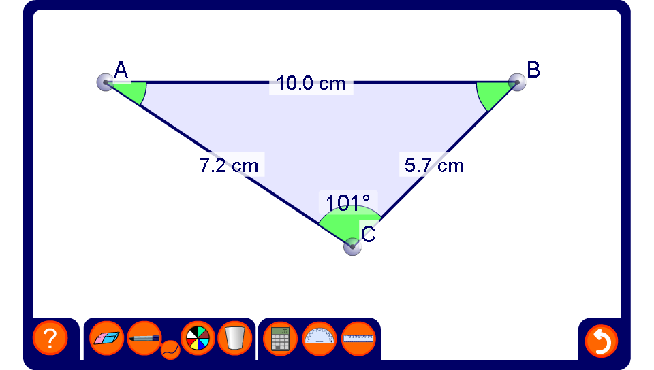


Using the cosine rule to find angles
Notes:
Be aware that the lengths of the sides and the angles have been rounded. This means that, for example, the three angles in the triangle may not add up to exactly 180°.
Change the shape of the triangle by dragging on the vertices.
Reveal the lengths of all three sides. Ask a volunteer to show how the cosine rule can be used to find the size of a required angle.

